Slide 1

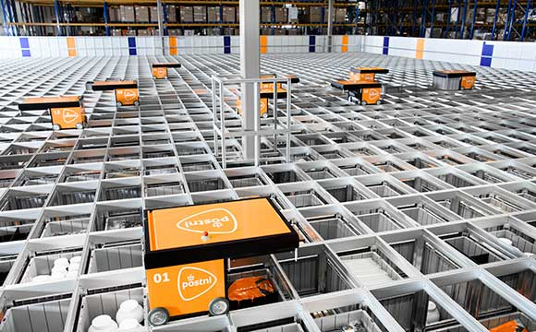
Parcel project

Slide 2
Content
introduction
What have we accomplished last week?
Further activitation for the next weeks
Questions

Slide 3
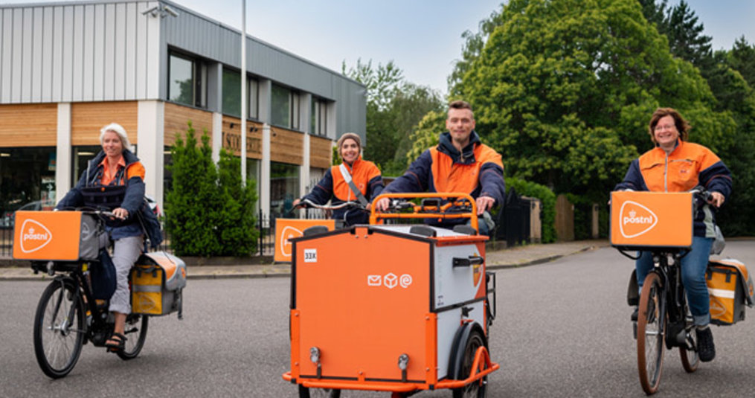
Introduction
Product owner: PostNL (Tim Ottens)
Assignment: Predicting the amount of processed packages for the next day
Data: amount of daily packages processed, for 300 customers, for 5 years

Slide 4
What have we accomplished so far?
ARMA, ARIMA, SARIMA
Multivariate Linear Regression model

Slide 5
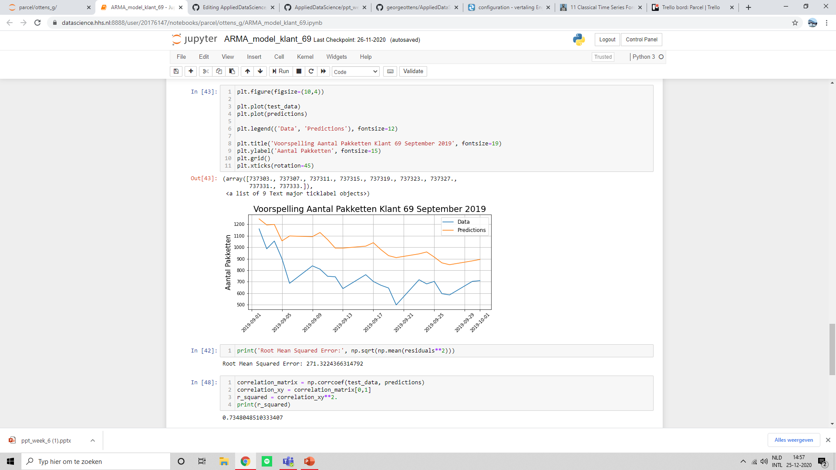
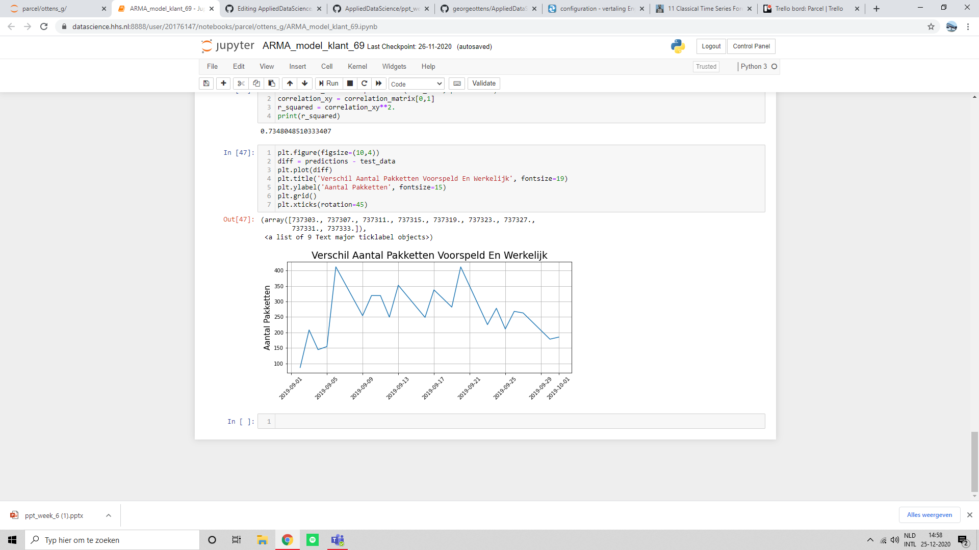
ARMA custom ID 69(real data)
ARMA Model
RMSE: 271
R^2: 0.73
Difference between real and predicted

Slide 6
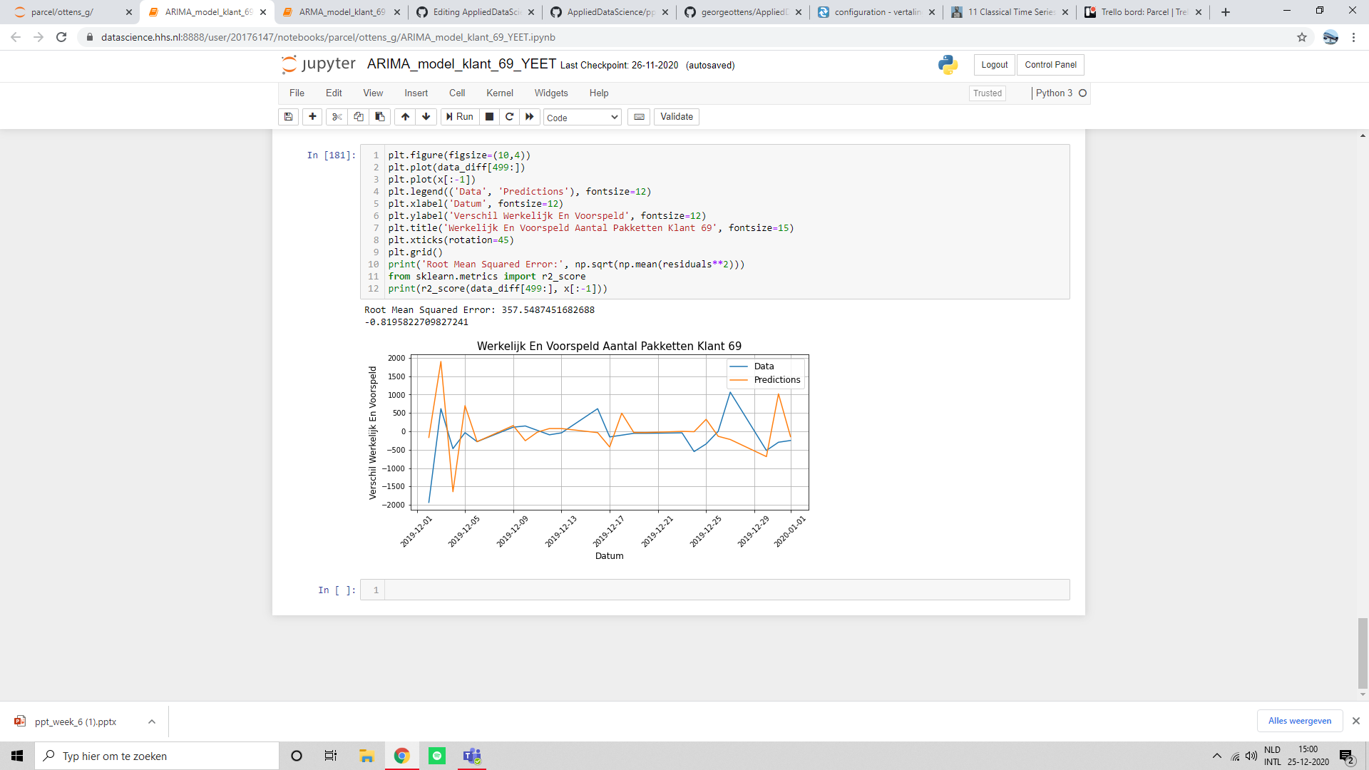
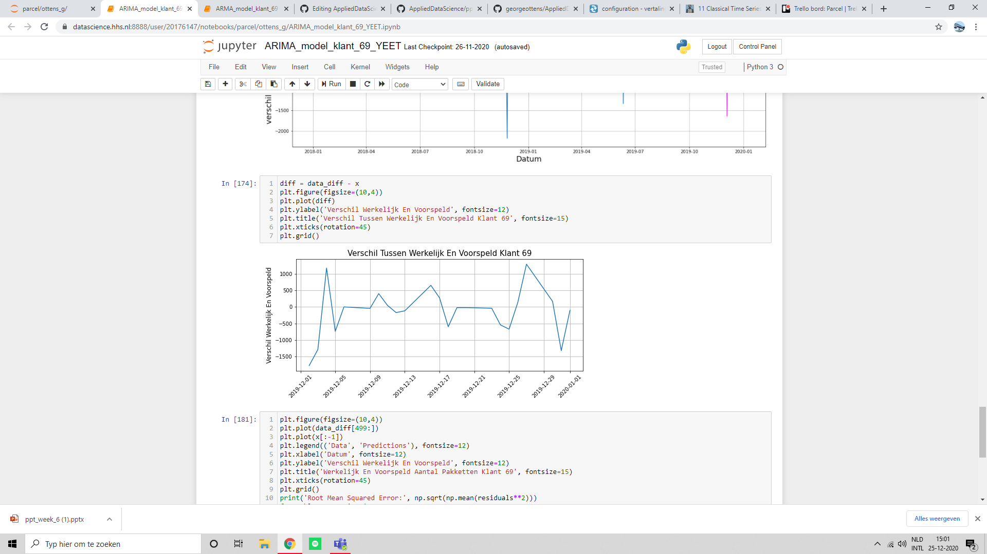
ARIMA custom ID 69(difference)
ARIMA Model
RMSE: 358
R^2: 0.82
Difference between real and predicted

Slide 7
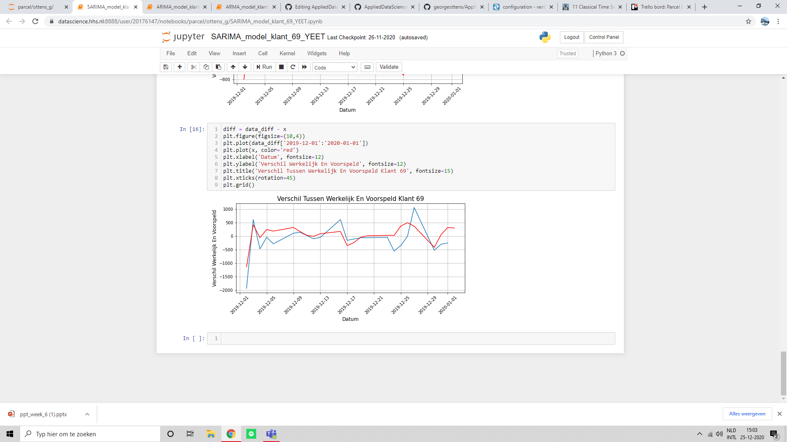
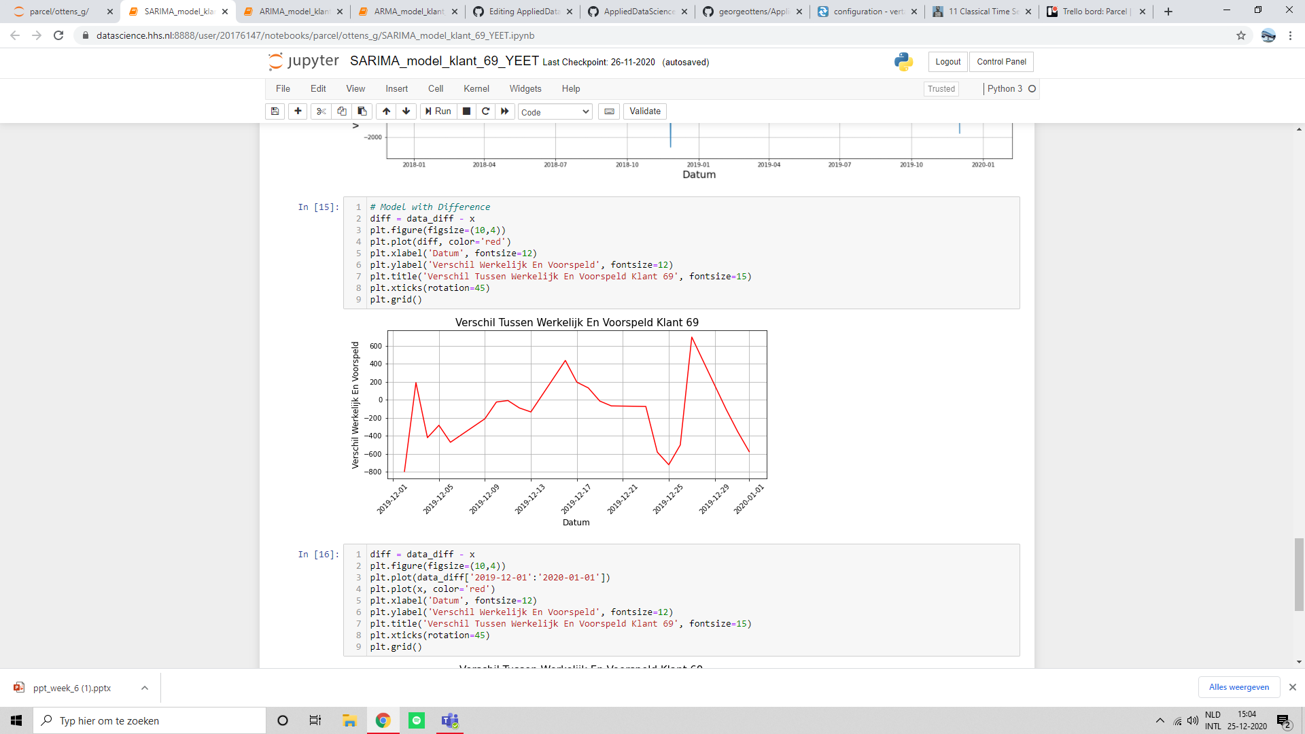
ARIMA custom ID 69(difference)
SARIMA Model
RMSE: 240
R^2: 0.84
Difference between real and predicted

Slide 8
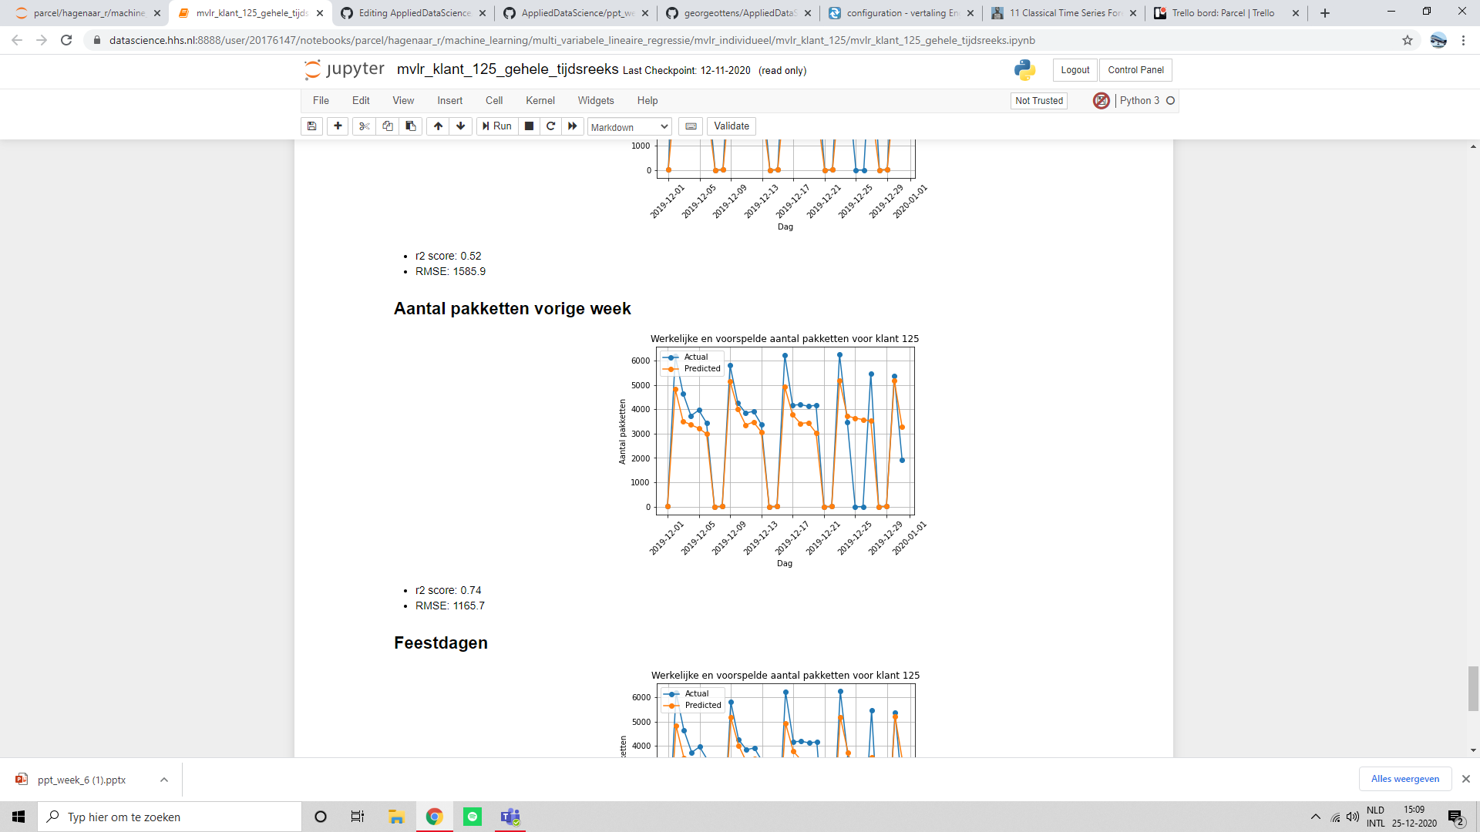
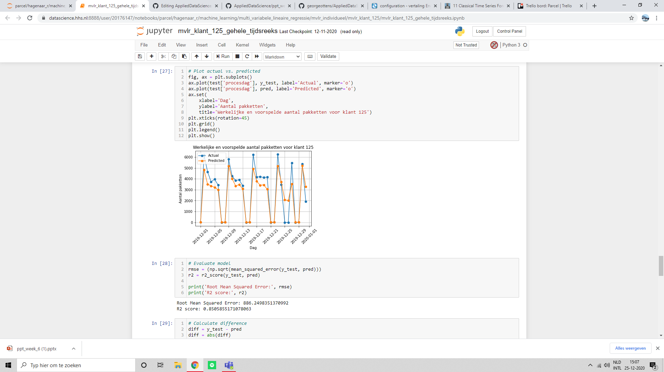
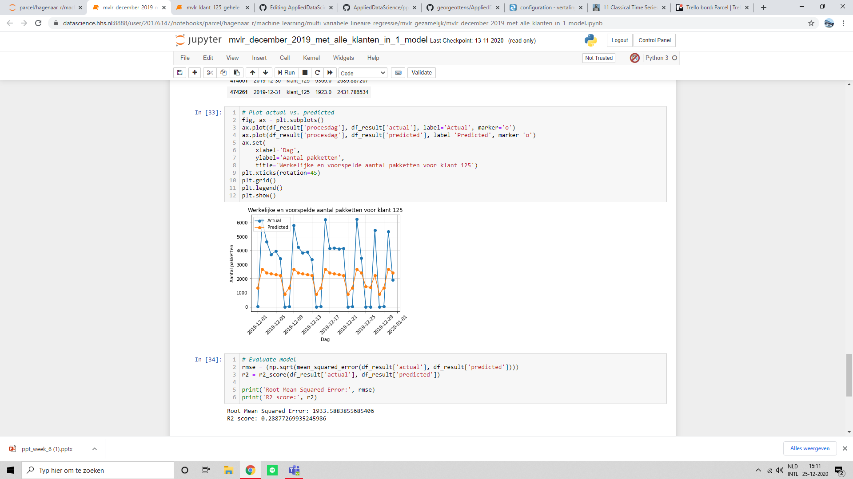
MVLR customer ID 125
With Last Week
RMSE: 1166
R^2: 0.74
With Holidays
RMSE: 886
R^2: 0.85
All the Customers
RMSE: 1934
R^2: 0.29

Slide 9
Further Activities
LSTM model setup
Look at Neural Networks

Slide 10

Questions

